Slide 1

Rectorial Vision & Strategic Action Plan (2026–2030)
University of Porto
Rectorial Final Presentation
Engr. Professor Lasisi Salami Lawal
24th April 2026

Slide 2
Portugal: A Legacy of Global Exploration & Knowledge
From the 15th–16th centuries, Portugal emerged as a dominant maritime power
Led the Age of Discoveries, shaping global trade, science, and cultural exchange
Built one of the first global empires, connecting continents
Established Portugal as a melting pot of cultures, ideas, and innovation
This legacy of exploration now evolves into intellectual and scientific leadership

Slide 3
From Maritime Exploration to Academic Leadership
The same spirit of discovery now lives within institutions like the University of Porto
A modern center for:
Knowledge creation
Global collaboration
Societal transformation
Today, the challenge is to lead a new era of intellectual exploration

Slide 4
University of Porto: Heritage & Distinction
Founded in 1911, one of Portugal’s leading public universities
Comprises 14 faculties and schools embedded within the city
Recognized as: Portugal’s most internationally cited research university, A top global institution (QS Ranking ~237)
Strong presence in: Engineering, Health Sciences, Business, AI
Deep integration with the city of Porto and regional economy

Slide 5
Strategic Challenges Facing U.Porto
Structural underfunding vs OECD peers
Infrastructure constraints within urban campus
Talent retention challenges (brain drain)
Administrative inefficiencies (e.g., Erasmus+ crisis)
Rapid digital transformation & AI disruption
Demographic pressures and declining youth population

Slide 6

Rectorial Vision (2026–2030)
To position the University of Porto as a:
Socially engaged university
Research-intensive global institution
Innovation-driven knowledge hub
Leader in international collaboration
Educator of responsible future leaders

Slide 7

Strategic Pillars for Transformation
Academic Excellence & Student Success
Research, Innovation & Knowledge Transfer
Internationalization & Partnerships
Social Engagement & Civic Responsibility
Institutional Sustainability & Digital Transformation

Slide 8
Academic Excellence & Student Success
Curriculum renewal aligned with future skills
Introduction of micro-credentials & flexible pathways
Teaching excellence programs for faculty
Student retention & inclusion strategies
Expansion of lifelong learning systems

Slide 9
Expected Outcomes & KPIs
Reduce
Reduce non-completion rates by 15–25%
Increase
Increase graduate employability by 10%
Launch
Launch scalable micro-credential programs
Improve
Improve student satisfaction and learning outcomes

Slide 10
Research, Innovation & Knowledge Transfer
Establish interdisciplinary Grand Challenge clusters
1
Expand internal funding & postdoctoral programs
2
Strengthen industry collaboration pipelines
3
Simplify IP and spin-out processes
4
Promote open science and research integrity
5

Slide 11
Impact & KPIs
Increase research income by 30%
Double industry partnerships
Launch 20+ startups/scaleups
Increase interdisciplinary publications

Slide 12
Internationalization & Global Partnerships
Strategic alliances with top universities
Expansion of joint degrees & mobility programs
Increased international student recruitment
Strengthened global research networks
Enhanced international student experience

Slide 13
Global Impact Targets
Increase international students by 25%
1
Establish 15 strategic partnerships
2
Improve global ranking and reputation
3
Expand EU-funded collaborations (Horizon, Erasmus+)
4

Slide 14
Social Engagement & Civic Responsibility
Partnerships with government, NGOs, and industry
Public lectures and community engagement programs
Citizen science and local impact initiatives
Strong Equity, Diversity & Inclusion policies

Slide 15
Societal Impact
Measurable community development outcomes
Increased regional economic contribution
Inclusive and diverse academic environment
Strengthened public trust in the university

Slide 16
Institutional Sustainability & Digital Transformation
Multi-year financial sustainability model
Transparent governance systems
Full digital university transformation (ERP, platforms)
Cybersecurity and data governance
Green campus and carbon reduction strategy

Slide 17
Strategic Outcomes
Balanced and diversified funding streams
Faster, data-driven decision making
Fully digitized academic ecosystem
Reduced environmental footprint

Slide 18
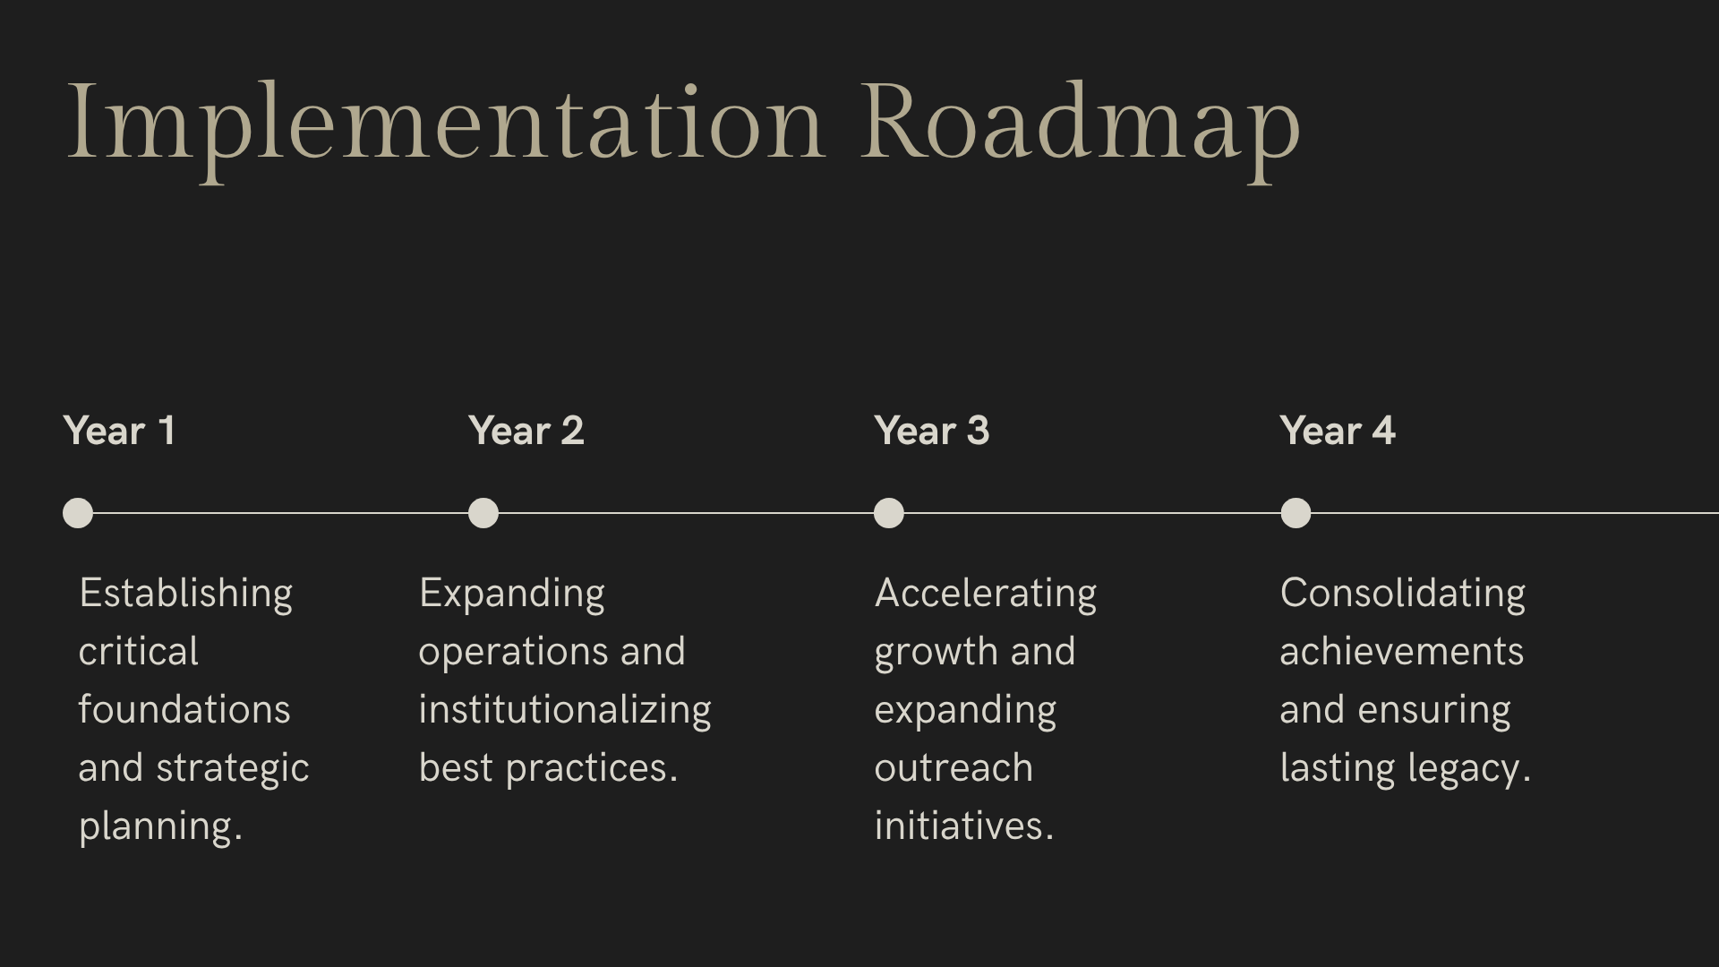
Implementation Roadmap
(2026–2030)

Slide 19
Governance & Accountability
Rector’s Executive Committee oversight
Strategy Office for execution tracking
Annual strategic board with stakeholders
Transparent KPI dashboards
Continuous faculty and student engagement

Slide 20
Closing Statement
The University of Porto stands at a defining moment
From maritime exploration to intellectual global leadership
This strategy ensures:
Excellence
Innovation
Global relevance
Societal impact
As an international individual, together, we will shape the next era of discovery

Slide 21
Thank you!

